Slide 1
What is the major issue of this paper?
How C. elegans embryos divide?
Whether gut differentiation dependents on inductive signals?
How to separate C. elegans blastomeres?
How to observe gut differentiation
None of above

Slide 2
What is the major approach that the author used to address his major question?
Antibody staining
Separation and reconstitution of blastomeres
C. elegans lineage analysis
Many other approaches

Slide 3
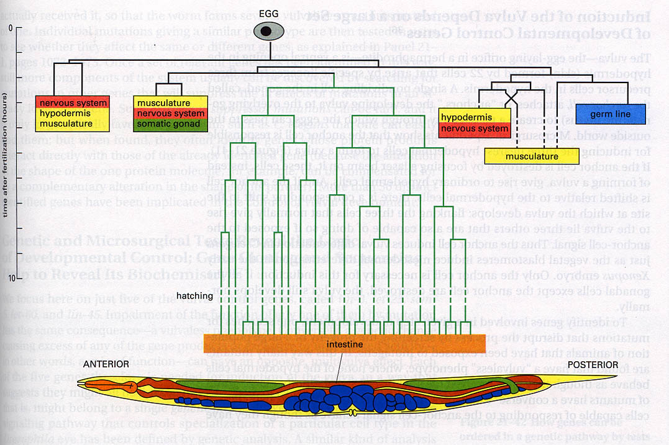
Embryo Development in C. elegans

Slide 4
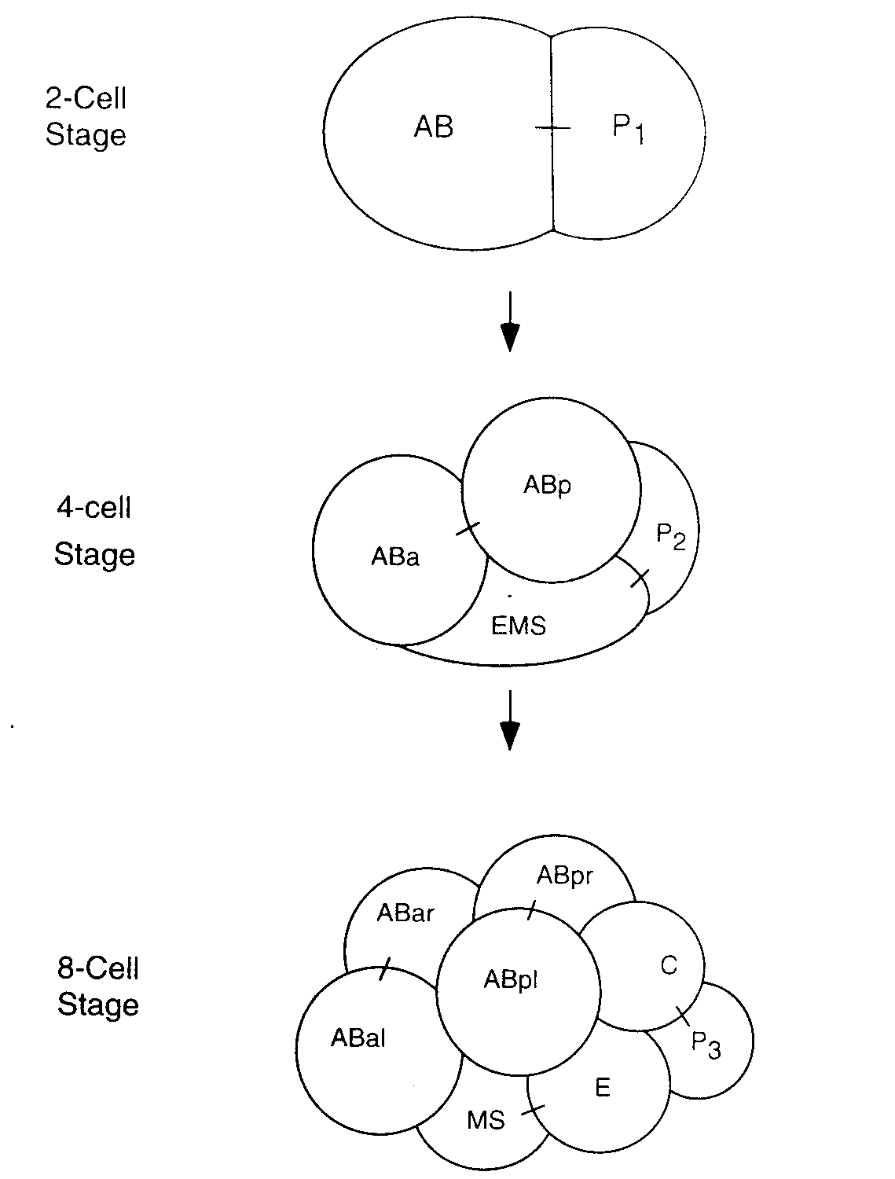

Slide 5
AB
P
AB
P
No differentiation
AB
P
P1 signals to AB

Slide 6
ABp
ABa
P2
EMS
glp-1
apx-1
ABa
ABa
ABp
EMS
ABa
P2
EMS
ABp
Genetic Screen
ABa
ABa
P2
ABa
P2
EMS
EMS
glp-1
apx-1

Slide 7
ABp
ABa
P2
EMS
Some time after cell division
Immediately after cell division
ABp
ABa
P2
ABp
ABp
ABa
P2
ABa
P2
EMS
EMS
P2
EMS
Gut
No Gut
Gut

Slide 8
ABp
P2
ABa
mom-2
EMS
mom-5

